Slide 1
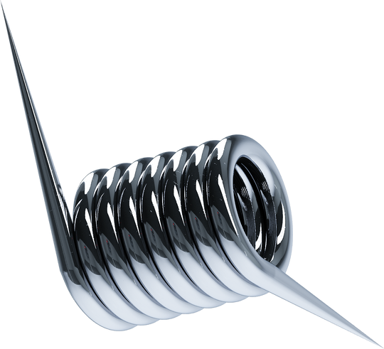
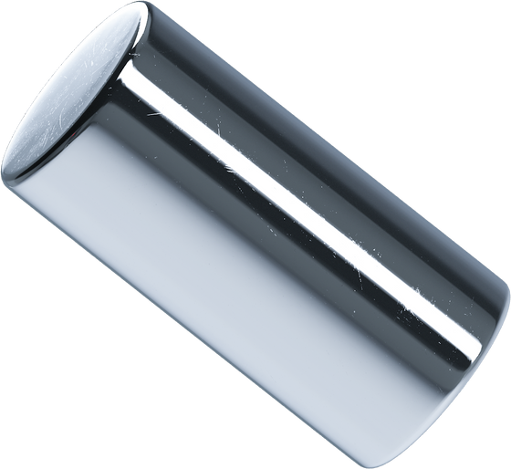
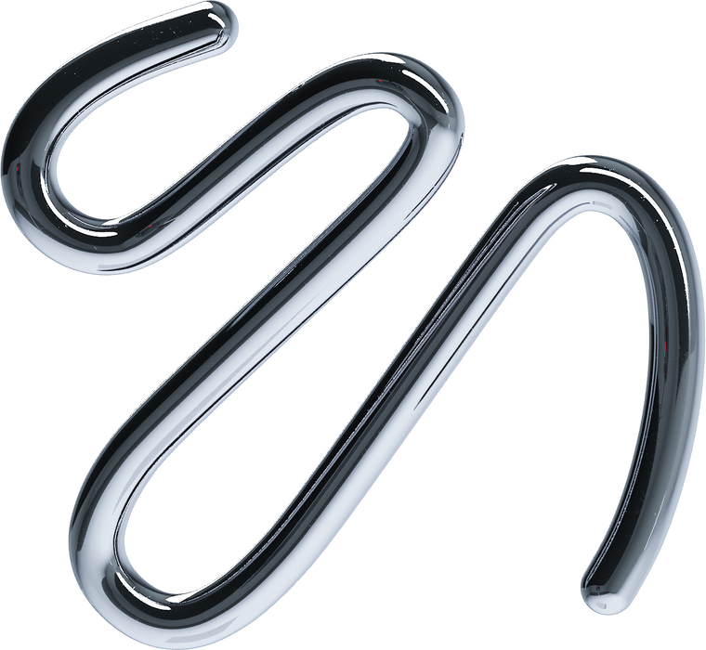
AN MLDA WORKSHOP
Integration Of Machine Learning with Web Development
Ng Ho Chi | Chay Hui Xiang

Slide 2


WOOCLAP
GITHUB REPOSITORY
wooclap.com/MLDAWEB
github.com/nghochi123/MLDA_Web

Slide 3
WOOCLAP
GITHUB REPOSITORY
wooclap.com/MLDAWEB
github.com/nghochi123/MLDA_Web.git

Slide 4


HO CHI
HUI XIANG
CS Year 2
linkedin.com/in/nghochi/
REP (CS) Year 2
linkedin.com/in/hui-xiang/

Slide 5

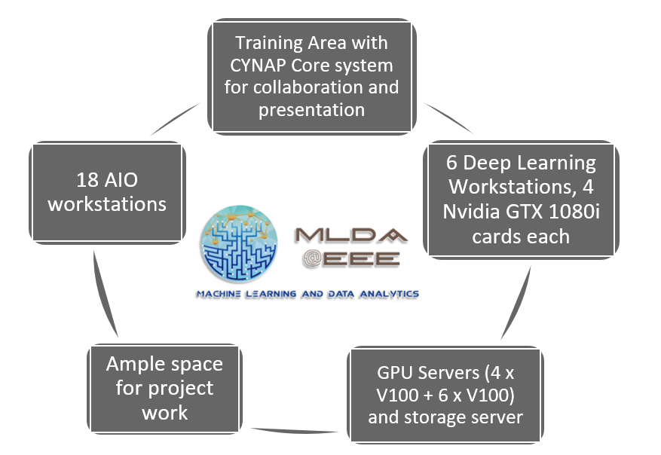
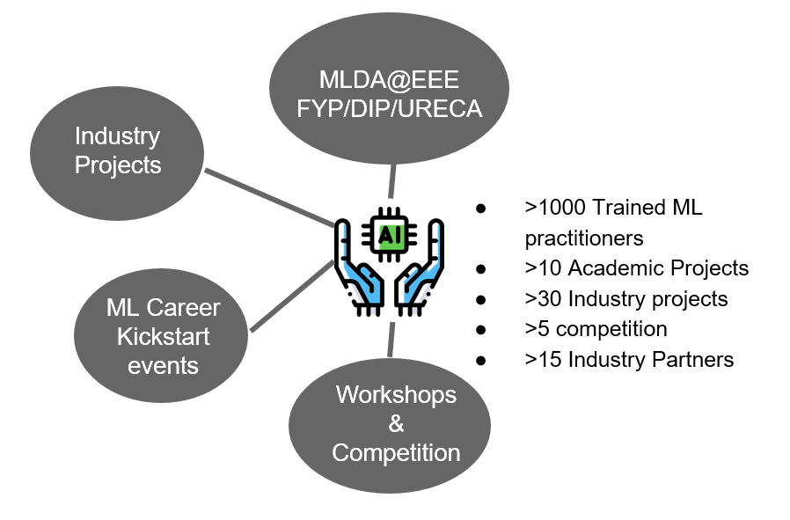

Slide 6

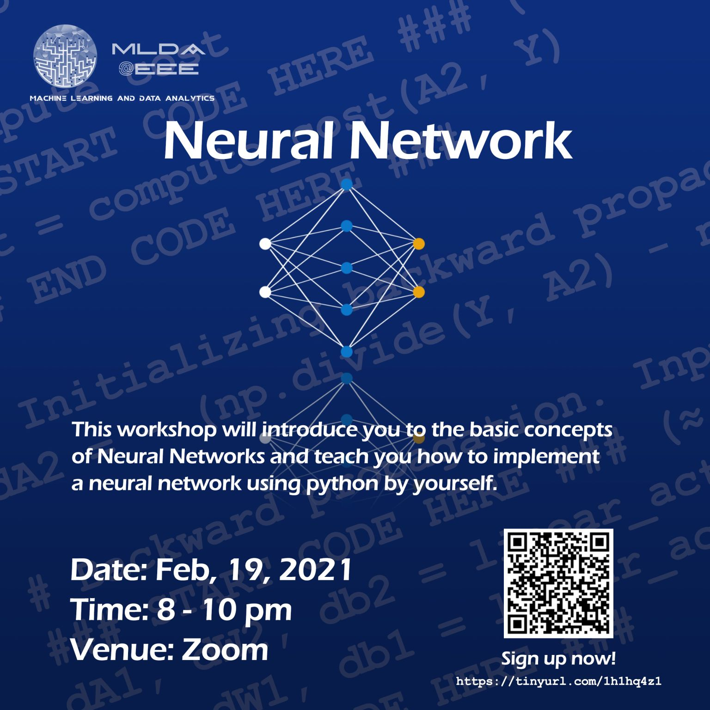


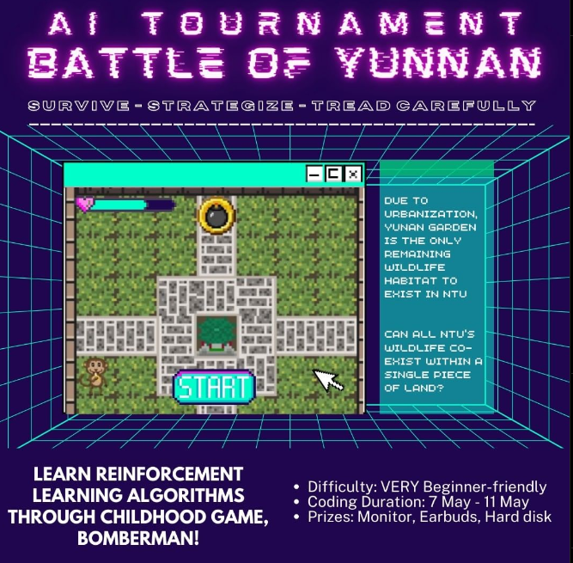
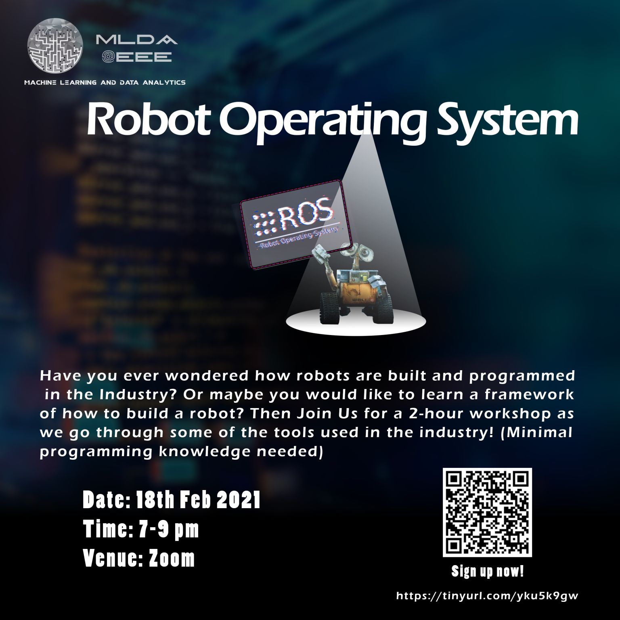


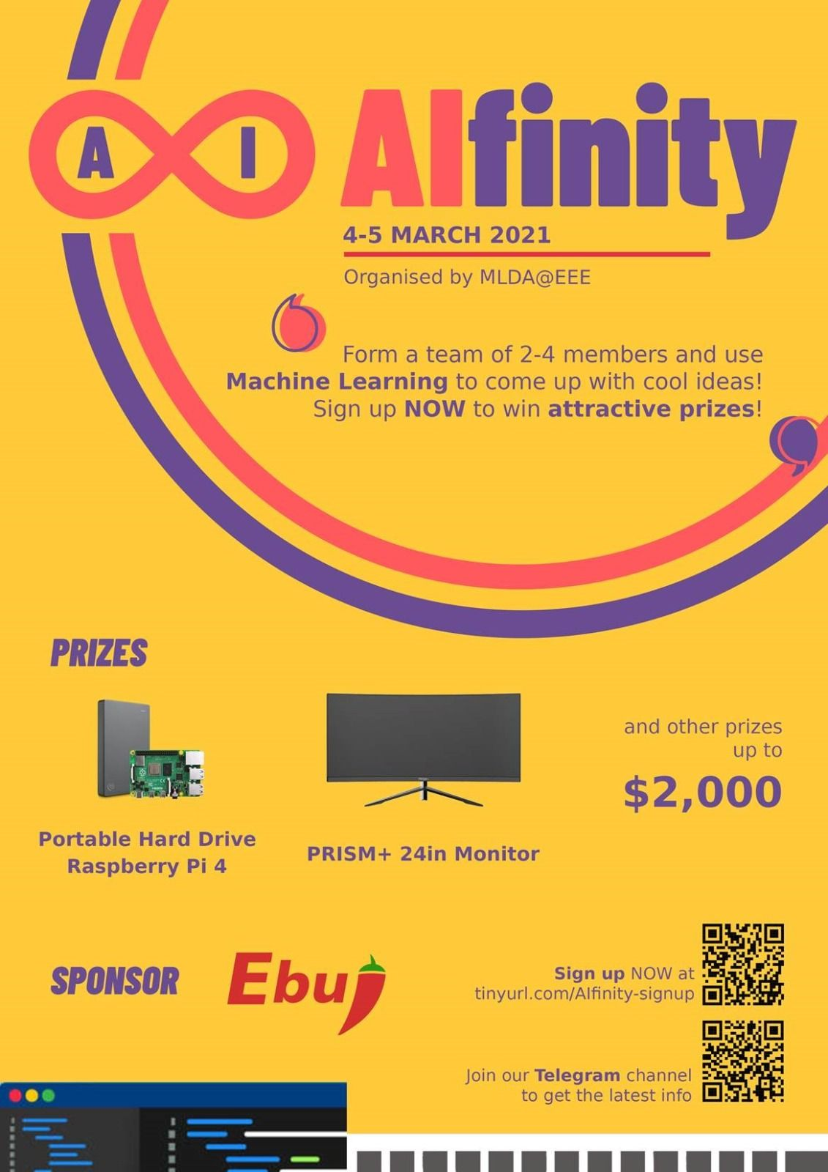
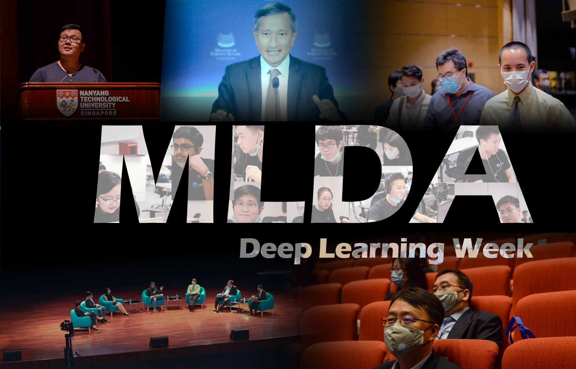

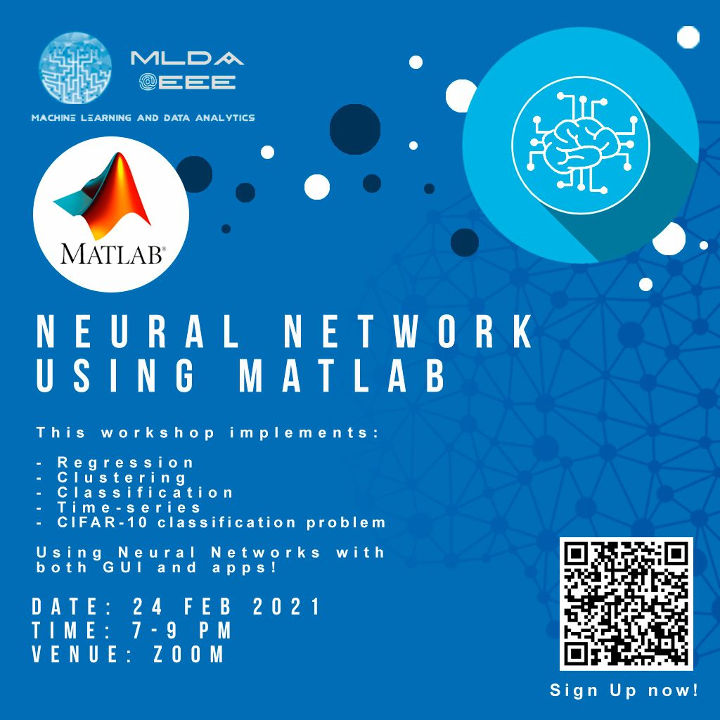


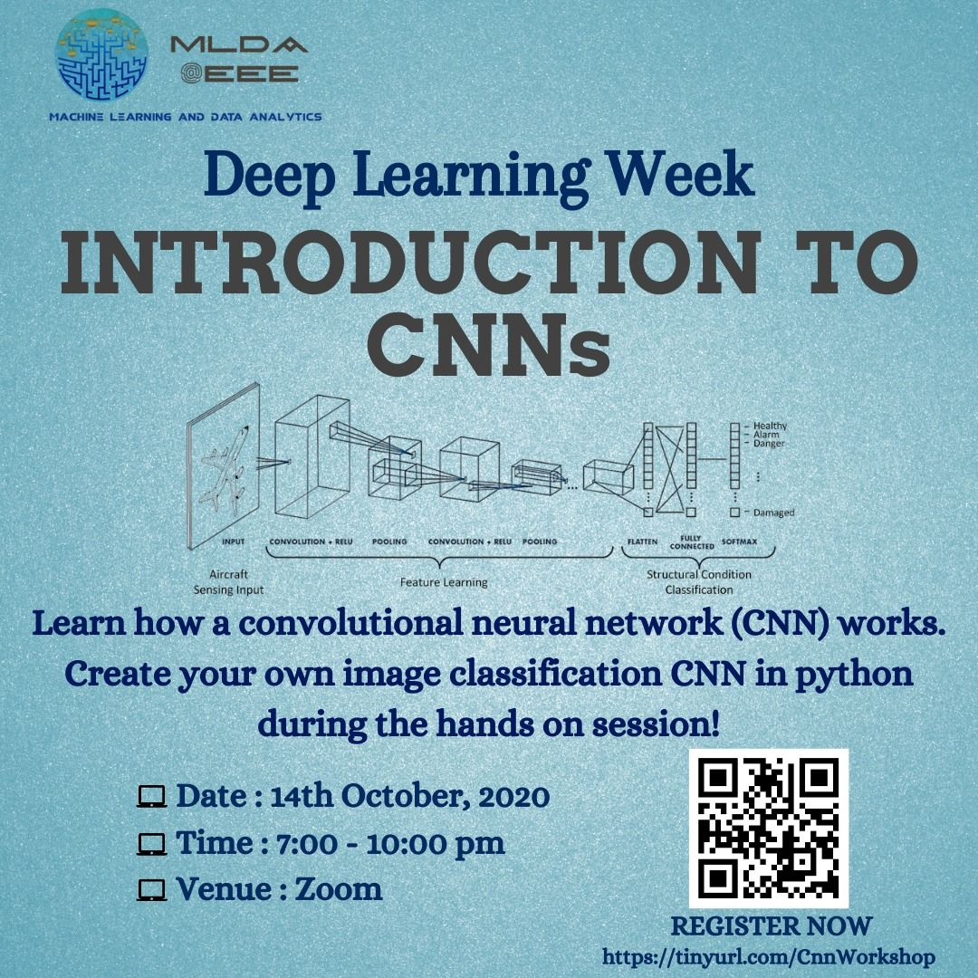
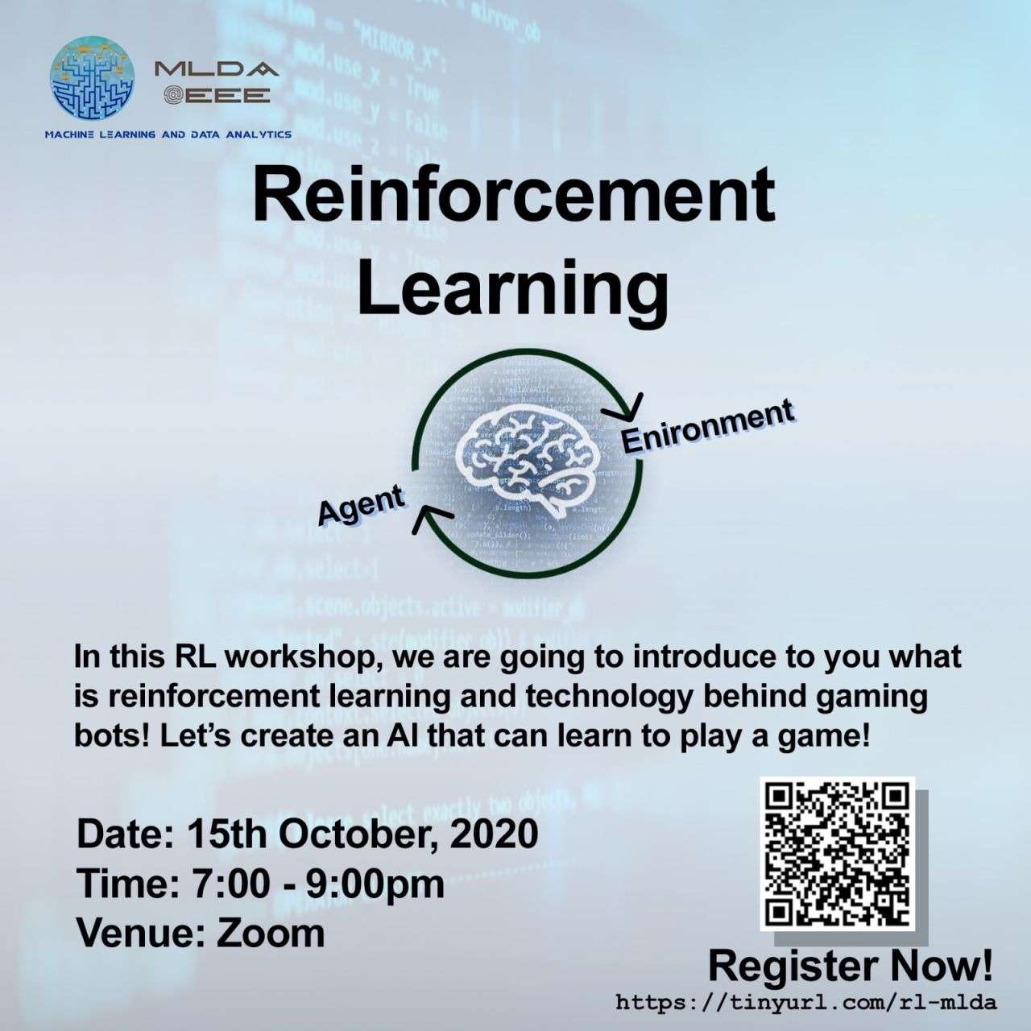
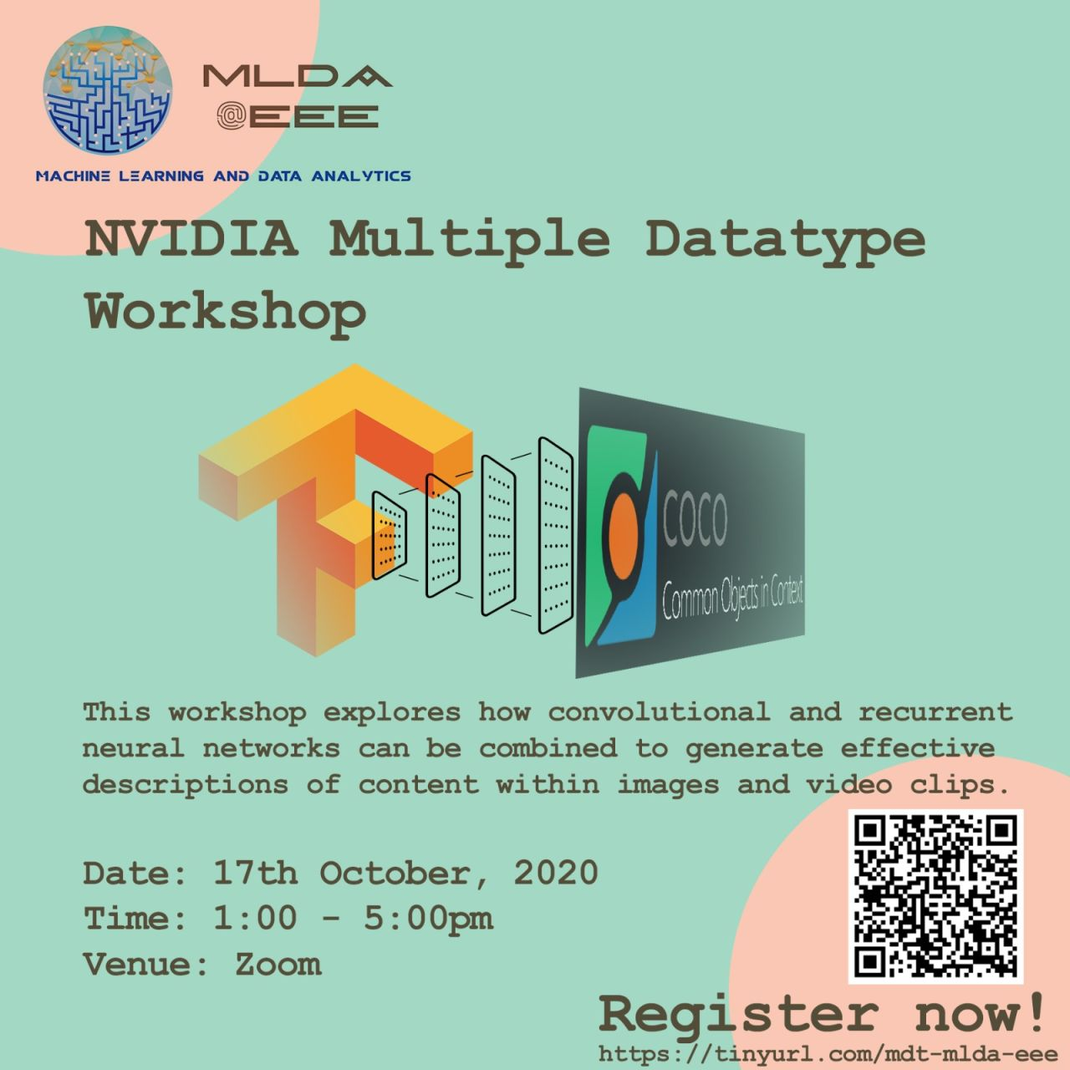
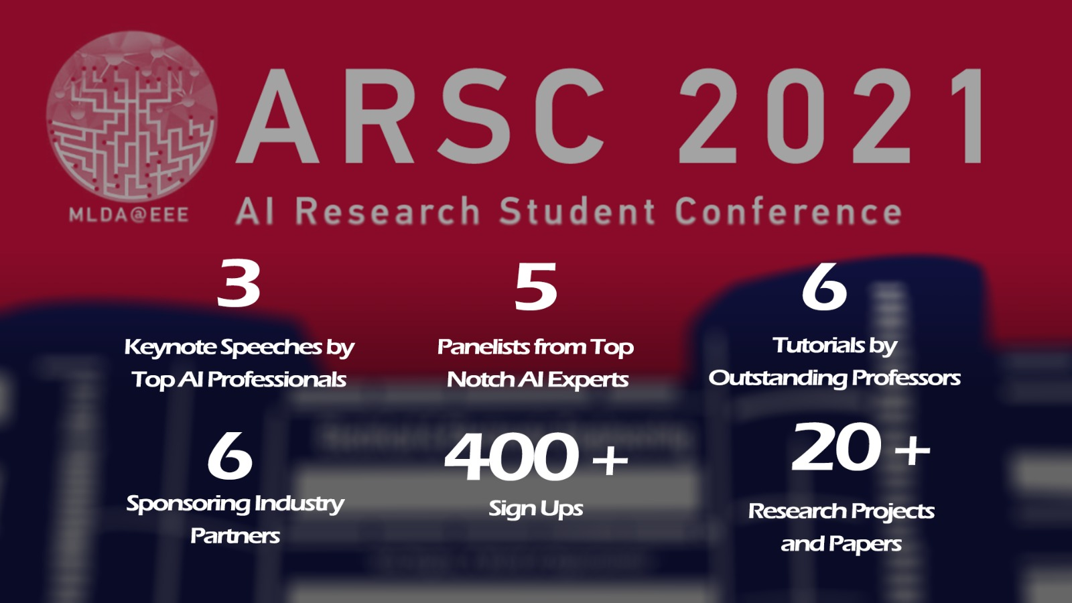

What we do
LEARN
APPLY
CONNECT
Listen to our workshops
Do projects that belong to yourselves
Hear from the industry
Notes:
MLDA@EEE is a student-led club, that aims to provide a platform to empower NTU students to pursue the application of Machine Learning, Data analytics and artificial intelligence. We do so by providing them with a place to learn, apply and connect with our industry partners and the academia

Slide 7
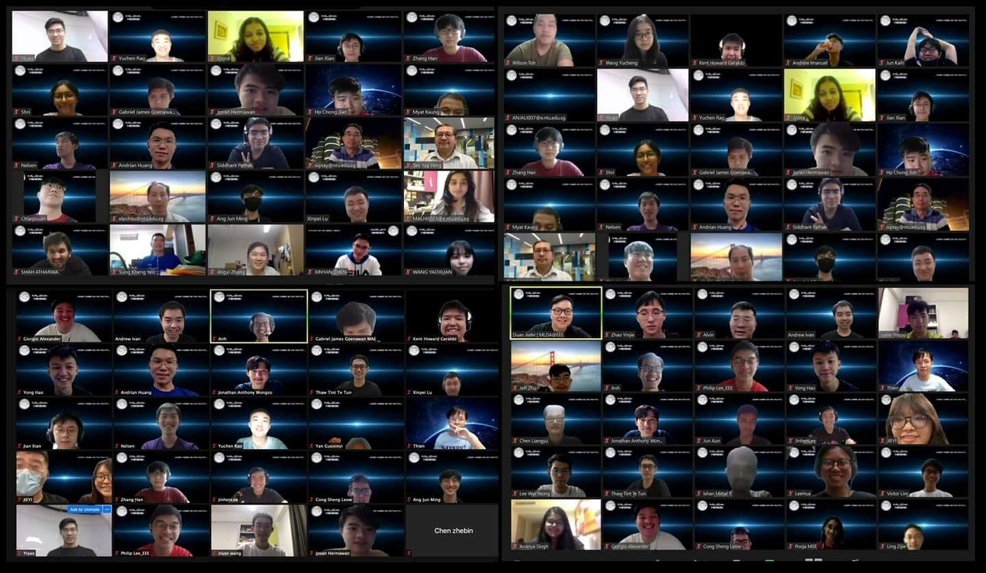
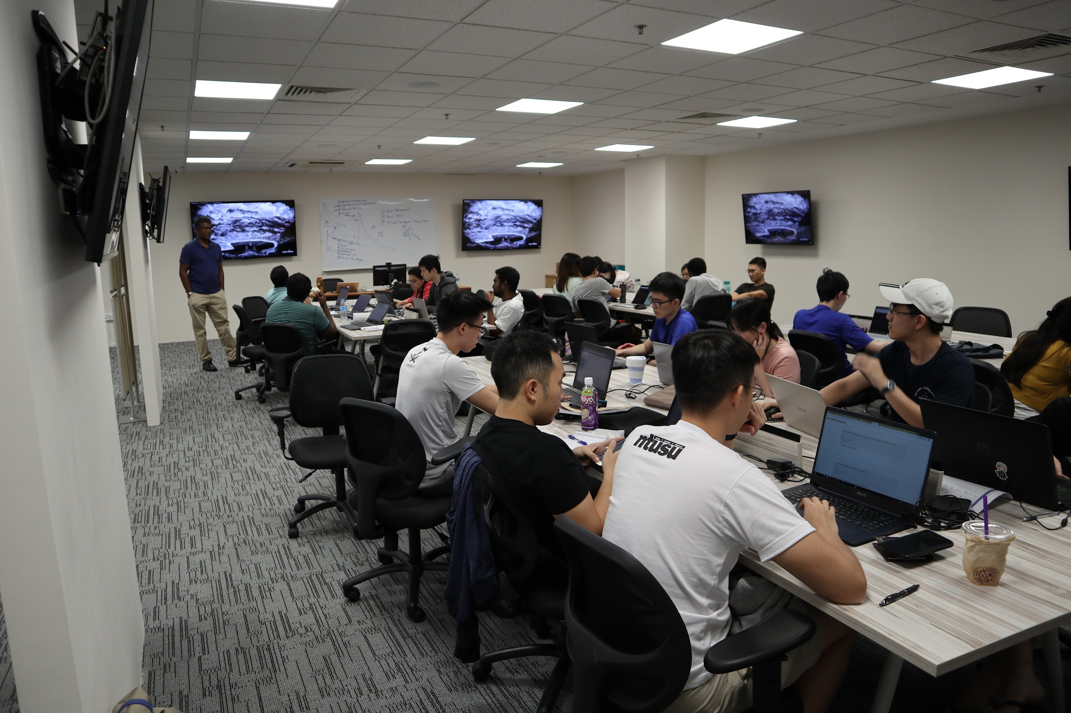
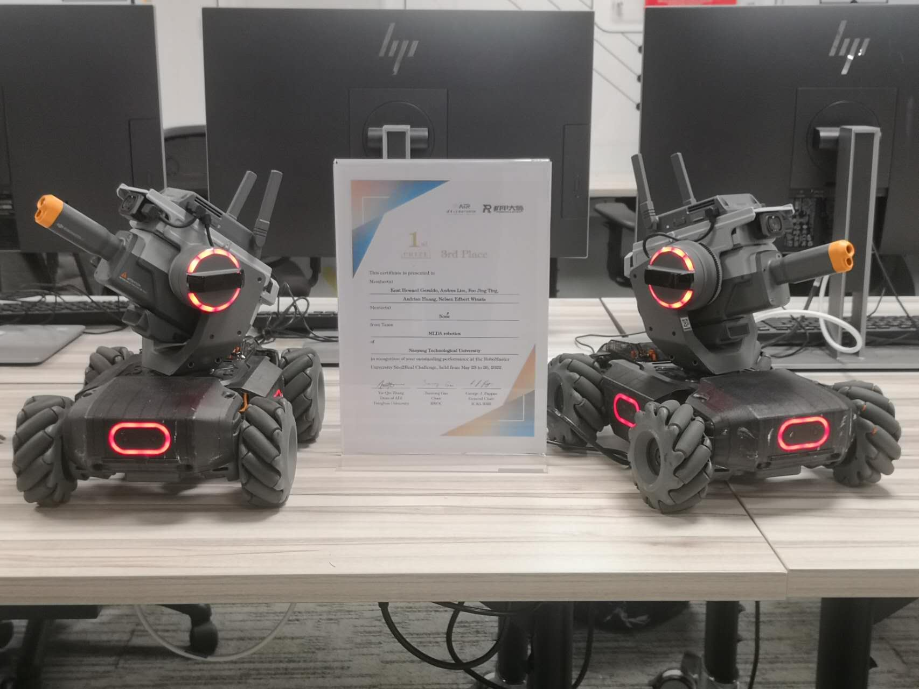
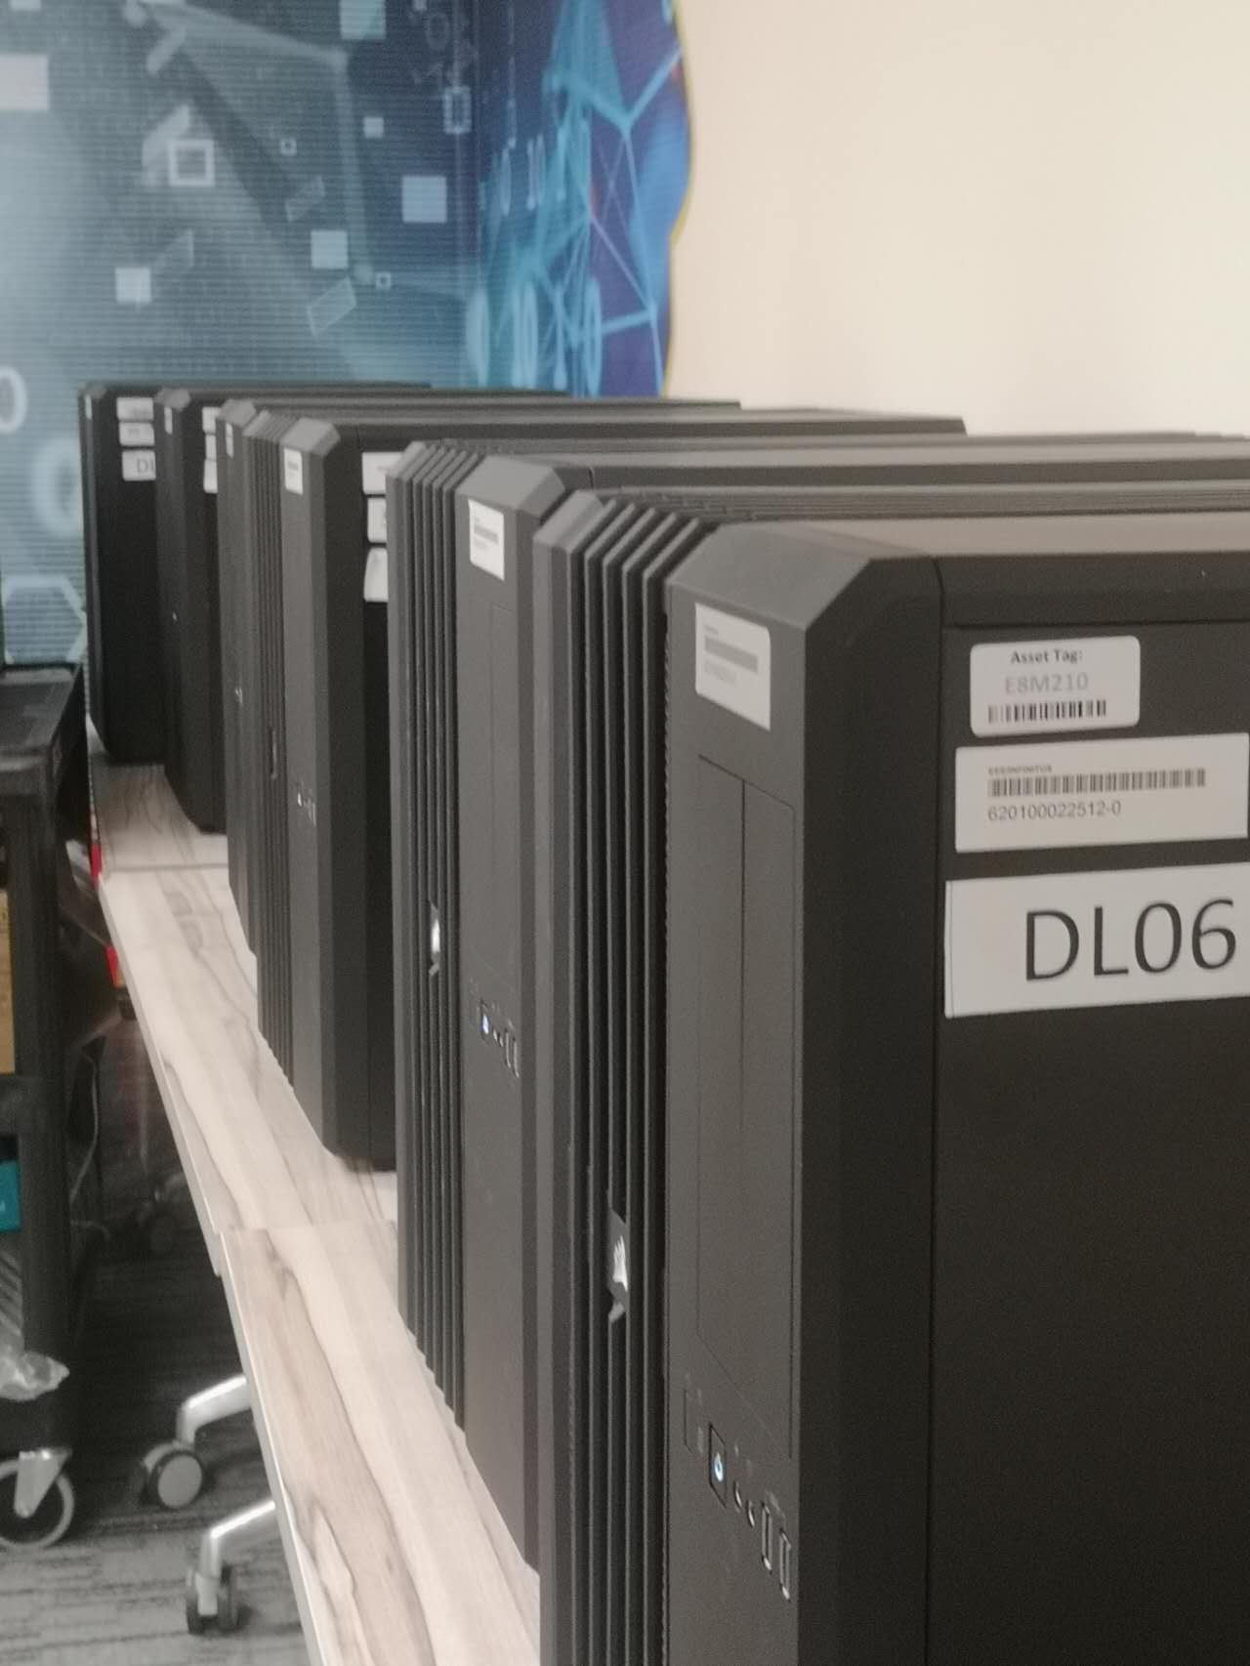






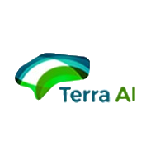







What we have
Like-minded Students in NTU
Project Partner / Research Partner
Friends in similar path of personal development
Academic facilities
GPUs
RTX 3090, GTX 2080 Ti, GTX 1080 Ti
Equipments
Robot Master *2
3D printer *1
Drones *1
…
Industrial Connections
Sponsors & Partners
Notes:
MLDA@EEE is a student-led club, that aims to provide a platform to empower NTU students to pursue the application of Machine Learning, Data analytics and artificial intelligence. We do so by providing them with a place to learn, apply and connect with our industry partners and the academia

Slide 8






Follow us to stay tuned!
https://www.ntu.edu.sg/eee/student-life/mlda
Machine Learning and Data Analytics at EEE NTU
Machine Learning and Data Analytics Lab at NTU EEE
@mlda_at_eee_ntu
MLDA-NTU

Slide 9
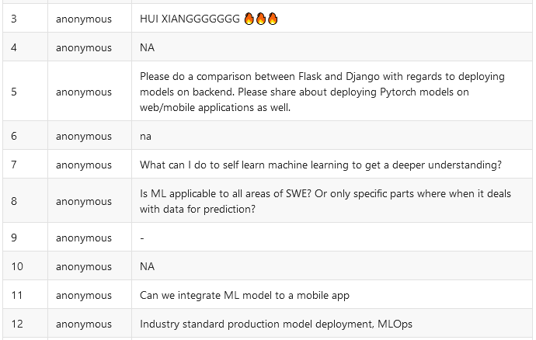

Questions
Addressed later

Slide 10
Our
Agenda
What is Machine Learning & Web Development
Why do we want to see Machine Learning with Web Development?
Python Implementations
Key topics covered
in this presentation
Javascript Implementations & Deeper Dive into TensorFlow.js

Slide 11
Our
Agenda
Key topics covered
in this presentation
What is Machine Learning & Web Development
Why do we want to see Machine Learning with Web Development?
Python Implementations
Javascript Implementations & Deeper Dive into TensorFlow.js

Slide 12
Prerequisites
Some Python & Javascript know-how would be good
Know a little bit of HTML
Knowledge of Node.JS would be good (for Javascript implementations)

Slide 13
Our
Agenda
What is Machine Learning & Web Development
Why do we want to see Machine Learning with Web Development?
Python Implementations
Key topics covered
in this presentation
Javascript Implementations & Deeper Dive into TensorFlow.js

Slide 14
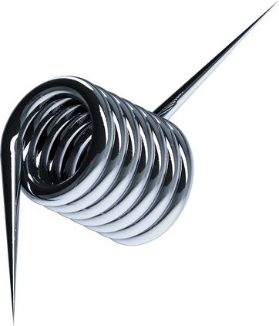
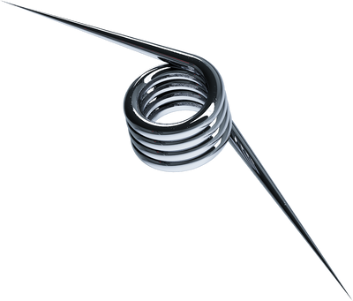
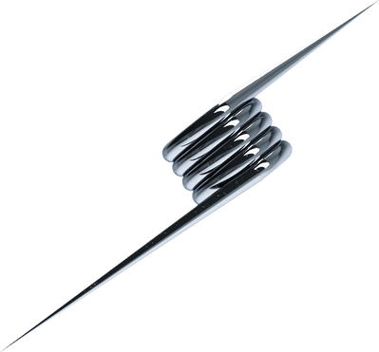
What is
Machine Learning
What is
Web Development
An application of AI that enables systems to learn & improve from experience without being explicitly programmed
Many different fields such as Computer Vision, Natural Language Processing, Recommenders, Time Series Forecasting etc.
Web Development refers in general to the tasks associated with developing websites for hosting via intranet or internet

Slide 15


HTML
CSS & JS
Static Sites
</>
Dynamically rendered Web Applications

Slide 16












HTML
Deeper Dive into frameworks
CSS & JS
Frontend, Backend, Databases
Static Sites
</>
Frontend
Backend
Databases
Express
Dynamically rendered Web Applications
React
Laravel
Angular
Django
Vue

Slide 17
Our
Agenda
What is Machine Learning & Web Development
Why do we want to see Machine Learning with Web Development?
Python Implementations
Key topics covered
in this presentation
Javascript Implementations & Deeper Dive into TensorFlow.js

Slide 18


Why should we use ML with Web Development?
Ability to demonstrate models gives research more credibility
Ability to for others to test your code before forking in open source
Allow others to train over cloud and provide data for your models
*Easier options are actually available (HuggingFace / Wandb)…
…but It’s COOL!

Slide 19
Our
Agenda
What is Machine Learning & Web Development
Why do we want to see Machine Learning with Web Development?
Python Implementations
Key topics covered
in this presentation
Javascript Implementations & Deeper Dive into TensorFlow.js

Slide 20

Building our Model
Follow along at the link here!: https://tinyurl.com/2p92dnuy

Slide 21








Deployment with Python

Slide 22
Deployment with Javascript
TensorFlow.JS on the frontend w/ HTML & JS
TensorFlow.JS on the backend w/ NodeJS

Slide 23
Break
5mins

Slide 24
Our
Agenda
What is Machine Learning & Web Development
Why do we want to see Machine Learning with Web Development?
Python Implementations
Key topics covered
in this presentation
Javascript Implementations & Deeper Dive into TensorFlow.js

Slide 25

What is TensorFlow.js?
JAVASCRIPT IS THE LANGUAGE OF THE WEB.
TensorFlow.JS facilitates the usage of ML directly
in the browser (on the client side) or in NodeJS (on the server side)

Slide 26


Syntactic Differences between TensorFlow (Py)
& TensorFlow.JS

Slide 27


# Python: from tensorflow import keras import numpy as np # Build and compile model. model = keras.Sequential() model.add(keras.layers.Dense(units=1, input_shape=[1])) model.compile(optimizer='sgd', loss='mean_squared_error') # Generate some synthetic data for training. xs = np.array([[1], [2], [3], [4]]) ys = np.array([[1], [3], [5], [7]]) # Train model with fit(). model.fit(xs, ys, epochs=1000) # Run inference with predict(). print(model.predict(np.array([[5]])))
// JavaScript: import * as tf from '@tensorflow/tfjs’;
// Build and compile model. const model = tf.sequential(); model.add(tf.layers.dense({units: 1, inputShape: [1]})); model.compile({optimizer: 'sgd', loss: 'meanSquaredError'}); // Generate some synthetic data for training. const xs = tf.tensor2d([[1], [2], [3], [4]], [4, 1]); const ys = tf.tensor2d([[1], [3], [5], [7]], [4, 1]); // Train model with fit(). await model.fit(xs, ys, {epochs: 1000}); // Run inference with predict(). model.predict(tf.tensor2d([[5]], [1, 1])).print();

Slide 28
# Python: from tensorflow import keras import numpy as np
// JavaScript: import * as tf from '@tensorflow/tfjs’;

Slide 29
# Python: from tensorflow import keras import numpy as np # Build and compile model. model = keras.Sequential() model.add(keras.layers.Dense(units=1, input_shape=[1])) model.compile(optimizer='sgd', loss='mean_squared_error')
// JavaScript: import * as tf from '@tensorflow/tfjs’;
// Build and compile model. const model = tf.sequential(); model.add(tf.layers.dense({units: 1, inputShape: [1]})); model.compile({optimizer: 'sgd', loss: 'meanSquaredError'});

Slide 30
# Python: from tensorflow import keras import numpy as np # Build and compile model. model = keras.Sequential() model.add(keras.layers.Dense(units=1, input_shape=[1])) model.compile(optimizer='sgd', loss='mean_squared_error') # Generate some synthetic data for training. xs = np.array([[1], [2], [3], [4]]) ys = np.array([[1], [3], [5], [7]])
// JavaScript: import * as tf from '@tensorflow/tfjs’;
// Build and compile model. const model = tf.sequential(); model.add(tf.layers.dense({units: 1, inputShape: [1]})); model.compile({optimizer: 'sgd', loss: 'meanSquaredError'}); // Generate some synthetic data for training. const xs = tf.tensor2d([[1], [2], [3], [4]], [4, 1]); const ys = tf.tensor2d([[1], [3], [5], [7]], [4, 1]);

Slide 31
# Python: from tensorflow import keras import numpy as np # Build and compile model. model = keras.Sequential() model.add(keras.layers.Dense(units=1, input_shape=[1])) model.compile(optimizer='sgd', loss='mean_squared_error') # Generate some synthetic data for training. xs = np.array([[1], [2], [3], [4]]) ys = np.array([[1], [3], [5], [7]]) # Train model with fit(). model.fit(xs, ys, epochs=1000)
// JavaScript: import * as tf from '@tensorflow/tfjs’;
// Build and compile model. const model = tf.sequential(); model.add(tf.layers.dense({units: 1, inputShape: [1]})); model.compile({optimizer: 'sgd', loss: 'meanSquaredError'}); // Generate some synthetic data for training. const xs = tf.tensor2d([[1], [2], [3], [4]], [4, 1]); const ys = tf.tensor2d([[1], [3], [5], [7]], [4, 1]); // Train model with fit(). await model.fit(xs, ys, {epochs: 1000});

Slide 32
# Python: from tensorflow import keras import numpy as np # Build and compile model. model = keras.Sequential() model.add(keras.layers.Dense(units=1, input_shape=[1])) model.compile(optimizer='sgd', loss='mean_squared_error') # Generate some synthetic data for training. xs = np.array([[1], [2], [3], [4]]) ys = np.array([[1], [3], [5], [7]]) # Train model with fit(). model.fit(xs, ys, epochs=1000) # Run inference with predict(). print(model.predict(np.array([[5]])))
// JavaScript: import * as tf from '@tensorflow/tfjs’;
// Build and compile model. const model = tf.sequential(); model.add(tf.layers.dense({units: 1, inputShape: [1]})); model.compile({optimizer: 'sgd', loss: 'meanSquaredError'}); // Generate some synthetic data for training. const xs = tf.tensor2d([[1], [2], [3], [4]], [4, 1]); const ys = tf.tensor2d([[1], [3], [5], [7]], [4, 1]); // Train model with fit(). await model.fit(xs, ys, {epochs: 1000}); // Run inference with predict(). model.predict(tf.tensor2d([[5]], [1, 1])).print();

Slide 33

Building our first ML model on the frontend!
https://codepen.io/subscribe-huixiang/pen/zYjJoNN

Slide 34

tfjs-node
tfjs
Deeper dive into NodeJS & Tensorflow
Endpoint: https://TensorflowJS-Node.chayhuixiang.repl.co/predict (POST)
Request Body (JSON)
Request Response (JSON)
{
“val”: 1
}
{
“prediction”: 1
}

Slide 35
tfjs-node
tfjs
Converting Pre-built models from Python to JS
Model Building: https://tinyurl.com/2p92dnuy
App Sandbox: https://codesandbox.io/s/thirsty-currying-dkwzq2
Deployed App: https://dkwzq2.csb.app/
# Inside Python
model.save(“my_model.h5”)
# Inside cmd/zsh/bash
# Activate virtualenv if you want (pyenv, virtualenv, conda)
pip install tensorflowjs
Tensorflowjs_converter –input_format=keras h5_file_path output_file_path
// inside TensorflowJS
const model = await tf.loadLayersModel(“path_to_model.json”)

Slide 36

Possibilities with ML Deployment
The boundaries are limitless!
CraiyoNFT
ADAP
& Many More!
Credits:
Hui Xiang, Ho Chi & Kevin
https://craiyonft.vmpsg.xyz/
Credits:
Hui Xiang, Nicholas, Marc,
Sui Kiat, Dao Zheng & Yu Fei
Demos: https://www.tensorflow.org/js/demos
Community Day:
https://www.youtube.com/watch?v=WvHr-yGnGPw

Slide 37
Wrapping Up…

Slide 38



Thank you.
All rights reserved to their respective owners and this workshop is solely for learning purposes. ​​Should you have any further questions or would like to voice out any errors in the materials, do feel free to reach out via chay0022@e.ntu.edu.sg / c210142@e.ntu.edu.sg.​​
HUI XIANG & HO CHI

Slide 39

Do you have any questions?
Send it to us! We hope you learned something new.

Slide 40
Questions

Slide 41
Benefits on Company Growth
How technology affects company growth
Increases efficiency
and productivity
Boosts innovation
Improves management
The right tools encourage businesses to develop better products, better processes, and better ways to do business.
Systems and platforms keep the company organized and on track to achieving business goals.
More efficient operations and higher productivity leads to success and expansion.

Slide 42
WHAT'S NEXT IN TECH WORKSPACE
Increased task automation and use of artificial intelligence.
Extra focus on high-value tasks.
Continuous investment in cybersecurity and security technology.
A better conscious focus on mental health.
Greater geographic distribution and representation of the workforce.

Slide 43
The Impact of Technology on How Companies and Businesses Work
Technology has changed the way companies and businesses work mainly by improving the efficiency of operations and increasing productivity.

Slide 44
The ease
of setting up
a remote team
STEP 1
STEP 2
Establish clear guidelines.
Recruit with scrutiny.
Hire the right people for the roles in the team.
Objectives and roles must be documented.
STEP 3
STEP 4
STEP 5
Invest on cloud technology.
Maintain team engagement.
Maximize communication.
Find the best support for the remote team.
Keep the team productive and motivated.
Use available channels to foster openness and collaboration.

Slide 45
HTML
Deeper Dive into frameworks
CSS & JS
Frontend, Backend, Databases
Static Sites
</>
FRONTEND
Dynamically rendered Web Applications
Increases efficiency
and productivity
Boosts innovation
Improves management
The right tools encourage businesses to develop better products, better processes, and better ways to do business.
Systems and platforms keep the company organized and on track to achieving business goals.
More efficient operations and higher productivity leads to success and expansion.

Slide 46
40
Remote Work Suitability by Industry
30
20
AS OF JANUARY 2021
10
More and more companies realize that certain job titles and profiles can be performed while working from home.
0
Item 1
Item 2
Item 3
Item 4
Item 5

Slide 47
WHAT'S NEXT IN TECH WORKSPACE
Increased task automation and use of artificial intelligence.
Extra focus on high-value tasks.
Continuous investment in cybersecurity and security technology.
A better conscious focus on mental health.
Greater geographic distribution and representation of the workforce.

Slide 48

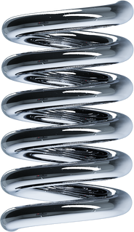
The Importance of Cybersecurity and Security Technology
PROTECTING THE COMPANY AND
ITS PEOPLE SHOULD BE A PRIORITY
As technology advances, the risk of security breaches also increases. Keeping financial data and confidential information safe and secure must always remain a top priority for any business.

Slide 49
Benefits of Technology

Slide 50
Benefits
on Employee Satisfaction and Commitment
Improves connection among employees
Having more channels to communicate fosters communication and collaboration - enabling employees to work more efficiently.
Raises productivity
Having the right systems and tools in place helps increase employees' productivity, boosting their performance and allowing them to have a sense of accomplishment.
How technology affects the staff
Encourages learning and development
Technology provides employees with access to resources and the means to learn and evolve.

Slide 51
Will remote work
become the new norm?
REMOTE WORK WILL CONTINUE TO BE VALUABLE.
Remote work allows companies to be flexible with how it conducts business. It also presents companies opportunities to rethink their strategies and innovate to become more efficient, more cost-effective, and more sustainable in the long term.

Slide 52
Effective communication and collaboration make the remote work setup successful.

Slide 53
Technology is nothing.
What’s important is that you have a faith
in people, that they’re basically good
and smart, and if you give them tools,
they’ll do wonderful things with them.
STEVE JOBS

Slide 54
Do you have any questions?
Send it to us! We hope you learned something new.

Slide 55






























Free Resources
Use these free recolorable icons and illustrations in your Canva design

